Slide 1
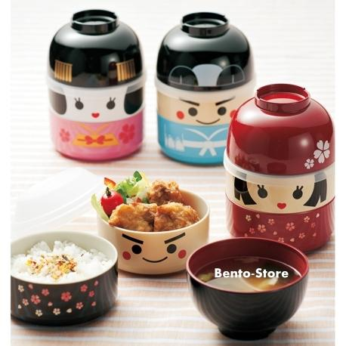
Kyaraben
(キャラ弁)

Slide 3
Bento
Believe it or not, bento (Japanese lunch boxes) were first developed by Samurai.
In 15th century, food logistics was a major problem for traveling armies. Samurai developed foods that were easy to transport and carry. These are considered precursors to Japan's much loved bento box.

Slide 5
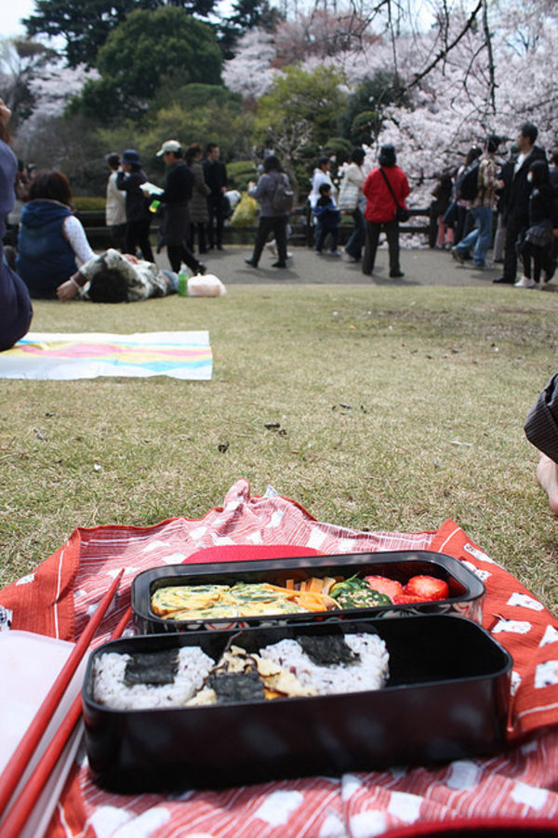
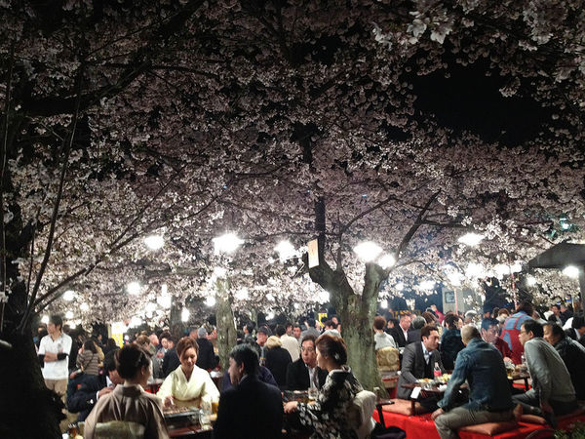
Bento Pastimes
Bento are an integral part of many of Japan's favorite pastimes. Everyone has enjoyed a bento under the sakura trees in Spring.

Slide 6
Factory Bento
The next step in bento innovation came with Japan's rapid modernization in the late 19th century after its markets were opened (by the American navy) in the 1850s.
Japan urbanized and industrialized faster than any other country in history. Great social turmoil prevailed. The development of bento boxes for the masses was a small part of the great change that characterized the Meiji-era.
Industrial workers made food at home and carefully packaged it for a long day at the factory. Within a short time office workers and school children were doing the same. Lacquer (and later aluminium) lunch boxes became all the rage. The modern bento was born.

Slide 7
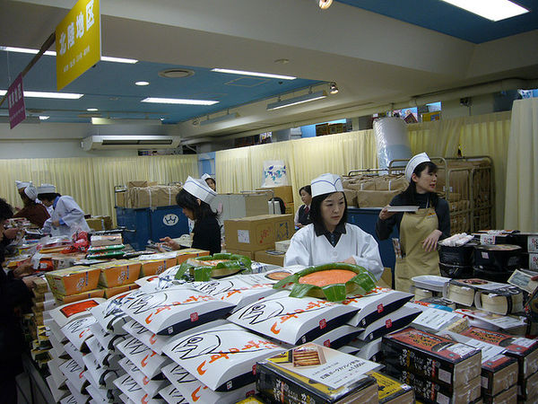
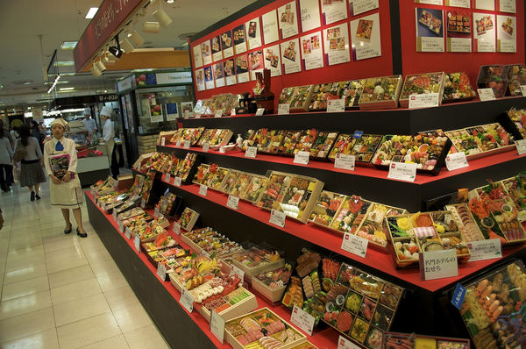
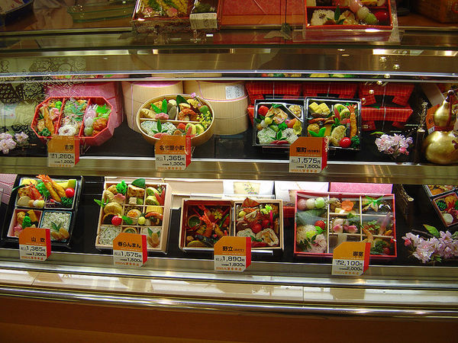
Bento Today
Today, most bento in Japan are mass produced and sold at bento shops, convenience stores, department stores, train stations, street stands and restaurants.
They're incredibly common. Most people in Japan eat at least one bento a week. It's not unusual for bento to represent over 50% of a person's diet.

Slide 8
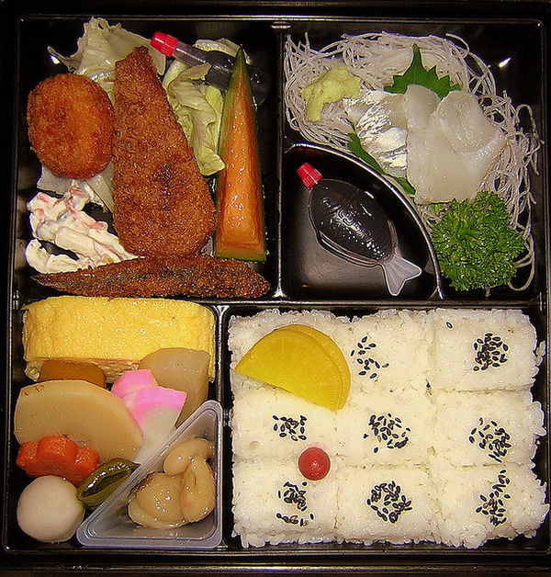
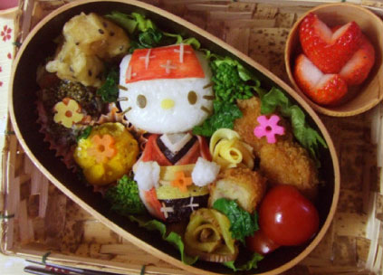

Slide 9
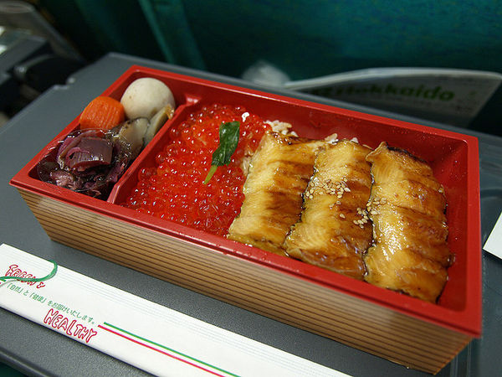
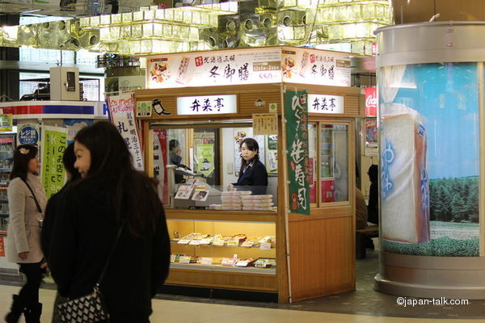
Ekiben
Ekiben are bento sold at train stations that are usually eaten on shinkansen and intercity express trains.
People in Japan are fond of taking the train. Ekiben is part of the experience. Each station has its own signature bento. Ekiben otaku (ekiben nerds) travel all over the country just to sample well known train lunch boxes. There are at least 10,000 distinctive ekiben sold at (or near) train stations throughout Japan.

Slide 10
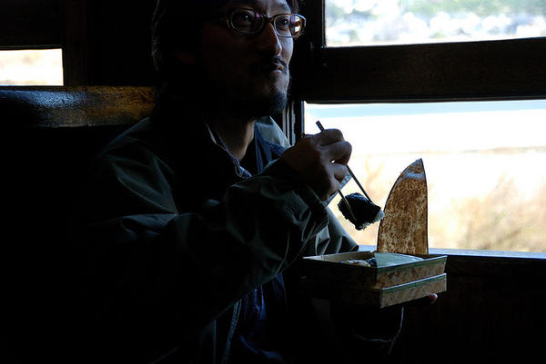
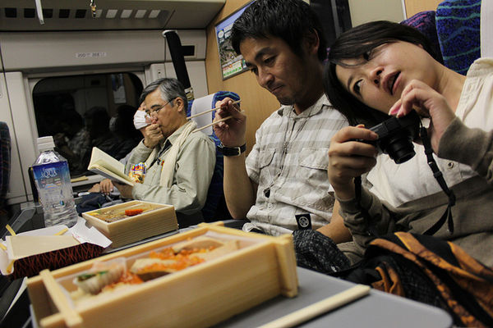
Many ekiben resemble fine food. Others come in collectible containers. Most ekiben highlight the regional cuisine of the station where they're sold. It's easy to see why people get so excited about them.

Slide 11
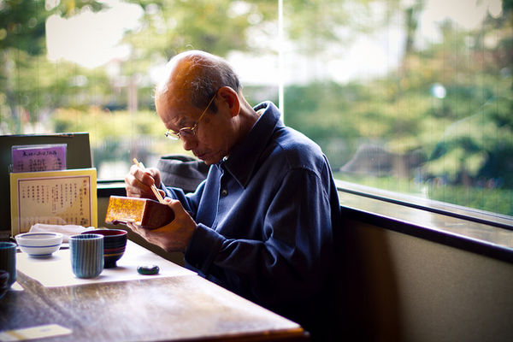
Teishoku
Teishoku is a "set meal" that's available at many restaurants in Japan (especially at lunch). Teishoku usually resemble a bento — they're served in boxes.

Slide 12
Kyaraben
Kyaraben or charaben (キャラ弁), a shortened form of character bento (キャラクター弁当 kyarakutā bentō), is a style of elaborately arranged bento (Japanese boxed lunch) which features food decorated to look like people, characters from popular media, animals, and plants. Japanese homemakers often spend time devising their families' meals, including their boxed lunches.
Most Kyaraben are made by mothers, who want to make their children’s lunches more appealing by arranging the contents of the Bento (lunch box) into their favorite cartoon characters or super heroes, intended to interest children in their food and to encourage a wider range of eating habits.

Slide 13
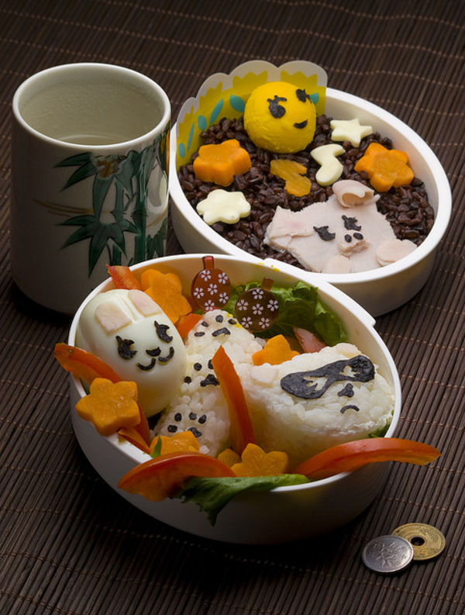
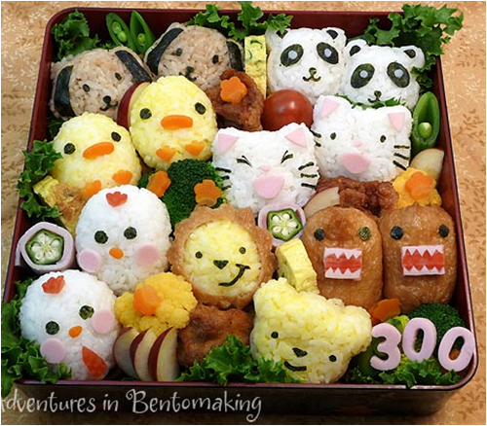
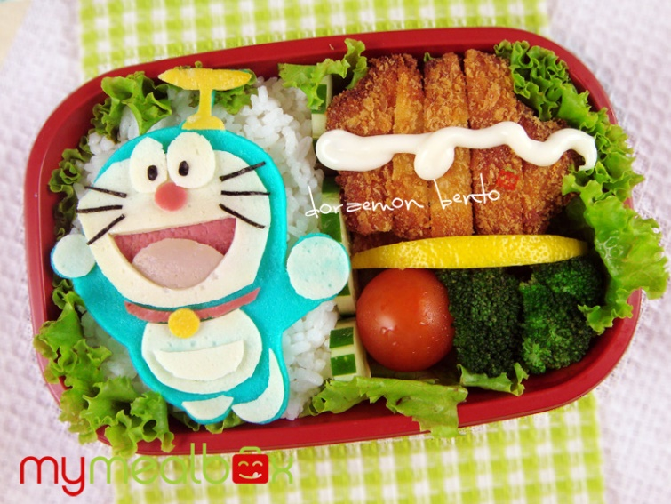
Kyaraben
At some point, somebody's mom sent them to school with a bento designed to look like a kawaii (cute) cartoon character. All the kids who saw it went home and begged their mom to do the same.
In the early 1990s, a new type of bento exploded on to the school lunch scene: kyaraben (Japanese English for "Character Bento"). People designed every bento imaginable — cartoons, celebrities, animals and famous artworks.

Slide 14
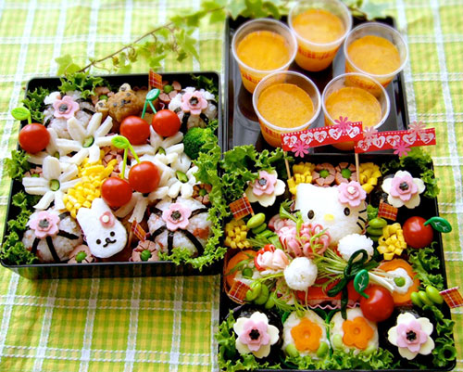
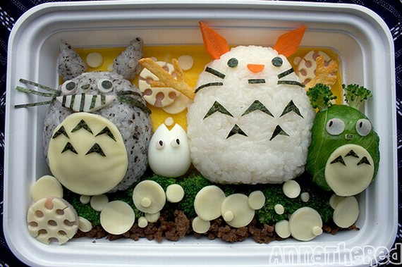
Today, kyaraben is bigger than ever. They're becoming a serious art form — annual kyaraben competitions now draw international competitors to Japan.

Slide 15
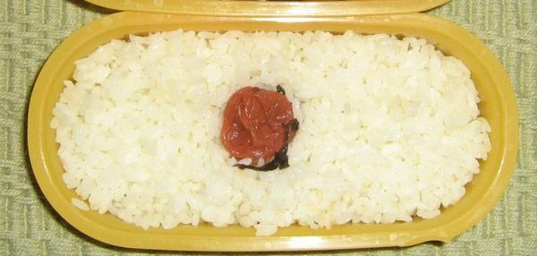
Hinomaru Bento
Perhaps it's the greatest honour Japan has bestowed on a food.
The hinomaru bento is designed to look like the Japanese flag. It features white rice with a bright red pickled ume plum (umeboshi) in the center.

Slide 16
Video links
Hello Kitty
https://www.youtube.com/watch?v=dcAF5CErJ3o&nohtml5=False
Pokemon
https://www.youtube.com/watch?v=hdgP9lOxxsk&nohtml5=False
Fruity
https://www.youtube.com/watch?v=TfQxyFECRMc

Slide 17
References
http://mymealbox.com
https://en.wikipedia.org/wiki/Kyaraben
http://www.japan-talk.com/jt/new/bento-basics

Slide 18
Terima Kasih

